Slide 1

CAD & Philosophy
1.1
When a person’s
Thought, Speech & Action are in positive direction he is more likely to achieve results.
When all these act in negative direction (as compared to his desires and targets) he is more likely to fail.

Slide 2

CAD & Philosophy
1.2
Some people act as under:
How can they achieve success?

Slide 3

CAD & Philosophy
1.3
When the target is Noble, for the good of the society, something else happens.

Slide 4

CAD & Philosophy
1.4
And the person will -

Slide 5
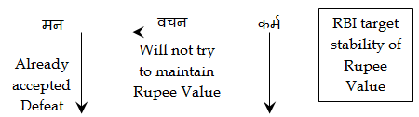
RBI
1.5
How can RBI succeed in achieving its targets?

Slide 6
Life moves in Cycles
1.6
In the human society there are several cycles working simultaneously.
Some are Virtuous.
Some Vicious Some Unpredictable,
Contradictory,
Directionless.

Slide 7
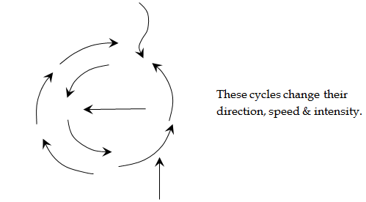
Chaos of Cycles
1.7

Slide 8
Chaos of Cycles
1.8
No situation is the result of a single cause.
Out of the multiple causes that affect, many are unknown.
Some are known but we don’t recognise their strength.

