Slide 1
Taxation of Digital Economy
Global Trends
Chamber of Tax Consultants Conference on MLI
5th October 2019
Presentation by
CA Rashmin C. Sanghvi

Slide 2
I. CONTENTS
I.1.2
Matters that will be discussed at the Conference.
Real Issues in Digital Tax.
COR Vs. COS conflict on Taxing Rights.
BEPS Action One. Proposals Difficulties.
Rashmin’s Proposal.
Digital Taxation Rashmin Sanghvi

Slide 3
II. CONTENTS
I.1.3
5. | Global Trends | (i) Business
 |  | (ii) Technology
6. | Global Trends in Law | (i) Chronology
 |  | (ii) Issues
 |  | (iii) Tax War between USA & Rest of the world
 |  | (iv) US Unilateralism
 |  | (v) OECD
 |  | (vi) India
 |  | (vii) EU
 |  | (viii) Others
7. | Future of International Tax War
Digital Taxation Rashmin Sanghvi

Slide 4
Digital Economy Taxation
I.1.4
Short Forms Used.
COR : Country of Residence
COS : Country of Source.
HOST : Country where immovable property or PE is located.
COM : Country of Market. This term is now accepted by OECD in its talks.
COP : Country of payment. This may be next step.

Slide 5
Digital Economy Taxation
I.1.5
Short Forms Used.
OBP : OECD. G20 BEPS Action One Public Discussion Document of February, 2019.
NR : Non – Resident.
PE : Permanent Establishment.
SEP : Significant Economic Presence.
E-Com.: Commerce conducted by electronic instruments.
D-Com: Commerce conducted by digital instruments.

Slide 6
Preface
I.1.6
I presume that all of you are experts in international taxation.
You are fully aware of developments till the year 2018.
Hence I will focus on OECD – G20.
BEPS Action One - Public Consultation
Document (OBP).
And
Global Trends.
I will also present my proposal.

Slide 7
PREFACE
I.1.7
Taxing a Non – Resident’s Income.
Cross Border Taxation.
International Tax.
When a person resident in COR earns income from some other country – COS / COM / COP; and both countries want to tax that income, it is called International Taxation.

Slide 8
Digital Economy Transaction
Jurisdiction
I.1.8
Main Issue is Jurisdiction.
NR would say “You have no jurisdiction to tax me.”
For Jurisdiction there must be a Nexus between the business entity & the Government that wants to Regulate it or Tax it.
Once a Nexus is decided one needs to compute taxable profits and Attribute a portion of the profits to the COM.

Slide 9
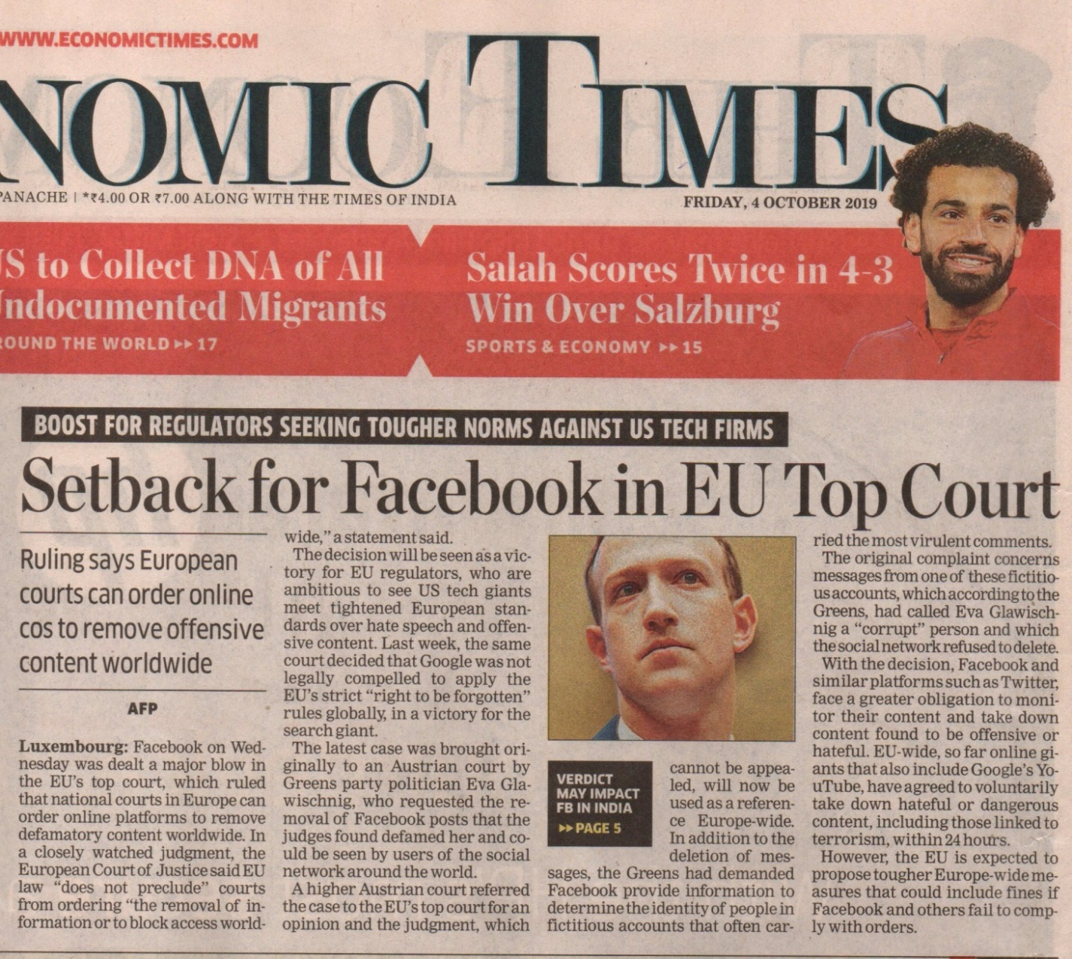
1.1.9
Matter of Jurisdiction has wide ramifications.
Law is yet evolving.

Slide 10
Why MNCs avoid COS tax ?
I.1.10
Why an MNC would not pay tax in India when it is getting set off under DTA?
Illustration:
Indian PE/SEP Revenue | 1,000
Indian Digital Tax (Assume) 3% | 30
US MNC – assume net profit | 200
US TAX @ 21% | 42
Set off available | 30
Tax payable in USA | 12
Why so much resistance in paying COS tax?
Notes:
Note: Equalisation Levy is not available as set off under DTA. Assume that Digital tax law is passed and DTA is notified.

Slide 11
Why MNCs avoid COS tax ?
I.1.11
  In reality, the MNCs do massive tax planning
  and pay almost ‘NIL’ tax in the COR on their COS revenue
  For them, set off is of no value.
  Whole tax in COS is a cost. And it runs into crores.
  So they resist.
  Note: Equalisation levy is not available as set off under DTA. Assume that Indian Income – tax Act is amended to subsume Equalisation Levy and DTA is modified to grant set off of Digital Tax.

Slide 12
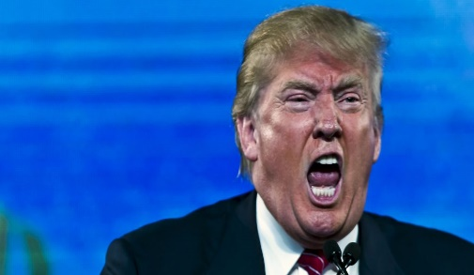
US Govt. Concern
I.1.12
    Why should US Govt. be concerned when its companies are taxed abroad ?
US Govt. is not only concerned. It is prepared to
go on an Economic War because of Digital
taxation.
Trump threatens Trade war with French Govt.
over 3% Digital tax.

Slide 13
US Revenue
I.1.13
  If a US tax payer pays tax in any other Country (COS) & claims set off against US tax-That is a direct loss of US Govt. revenue.
  Hence action by USA: Strike at the root. If OECD model does not permit COS to tax Digital Commerce, then US won’t suffer the tax.
  Protest against Unilateral tax law. Insist on OECD model.
  Manage OECD Model and BEPS Action One Final Report to suit American interests.

Slide 14
What is the Digital
International Tax problem?
I.1.14
All international taxation is about sharing of income-tax revenue between or amongst two or more countries.
Sharing of Income-tax revenue depends upon:
Nexus - PE &
Attribution of Profits.
Digital Taxation Rashmin Sanghvi

Slide 15
What is the Digital
International Tax Problem?
I.1.15
1. Digital Tax Problem Nexus:
COS can tax a NR’s income only if the NR has a Nexus/PE in COS.
PE requires – mainly a fixed base, a connection within the COS.
Digital Economy has made geographical boundaries redundant. Hence one cannot establish Nexus under existing rules. (This was pointed out in the year 2000.).
India & EU have presented the option of SEP. There are different options on the table.

Slide 16
Significance of Attribution of
Profits to COM
I.1.16
The profit attributed to COM becomes the Tax Base for COM.
In other words, the COM can levy Income-tax on this amount.
India has offered some rules. BEPS has presented different options.

Slide 17
Digital International Taxation
I.1.17
When someone uses the term Digital Economy – a Question arises:
Have they still reached the root of the problem?
This is a far more important issue from a long term perspective.

Slide 18
Double Tax Avoidance by US MNCs
I.1.18
Digital Taxation Rashmin Sanghvi
Google, Facebook, Apple, Amazon etc. devised elaborate plans.
  For sales within USA, pay tax.
  For sales outside USA-
COS tax was avoided because of faulty OECD model. “Do not allow OECD model to be changed” was an important part of the scheme.

Slide 19
Double Tax Avoidance by US MNCs
I.1.19
Use Ireland as tax haven. Park global profit in Irish SPV. Avoid US Anti- Avoidance provisions like- Transfer pricing, Controlled Foreign Company, etc. Pay next to Nil tax in Ireland.
No tax in USA.
No tax in COS.

Slide 20
Challenges Raised by Digitalisation
I.1.20
Jurisdiction - Nexus.
Attribution of Profits.
Free service – Revenue from advertisement.
Data collection.
There will be many more issues in future
- Which we have not thought about
- and for which even the BEPS proposals are not ready.
6. Tax Avoidance/ BEPS is easy
We need a dynamic law that can be changed with changing technologies & changing business models.
Digital Taxation Rashmin Sanghvi

Slide 21
COR COS Conflict
I. 2.1
COR
Digital Taxation Rashmin Sanghvi
Many Different factors contribute to the profit:
Assesses’s own contribution/
Value addition
(ii) Contribution to conduct production
business by COR Governments.
Profit attributed to these factors may be taxed by COR.

Slide 22
COR COS Conflict
I. 2.2
(iii) Buyer’s / Consumer’s contribution.
Prices are - decided by “what the
market can bear” principle.
(iv) COS Government’s contribution to
conducive market conditions
Profits attributed to these factors may be taxed by COS/COM.
COS/COM

Slide 23
COR COS Conflict
I. 2.3
There is no profit in absence of-
Either COR
Or COS.
Both contribute to the profits.
And both must have a right to tax cross border profits.
Both should have equal right. 50% of profit to be taxed by each country. (Note. This can be subject to further discussions.)
Digital Taxation Rashmin Sanghvi

Slide 24
COR COS Conflict
I.2.4
Striking at the Roots.
You may remember:
Pharmaceutical Companies would motivate professors in Medical Colleges to teach the students on desired lines.
American Pharma companies motivated World Health Organisation to predict wide spread epidemic of a viral disease.
All their stocks of medicines were sold out at good prices. Eventually, there were cases of viral disease. But no epidemic.

Slide 25
COR COS Conflict
I.2.5
iii. Get OECD model designed to suit COR interests. Several generations of professors will teach, students will learn & tax commissioners will implement laws that favour COR.
Get BEPS reports & MLI drafted to suit USA.

Slide 26
COR COS Conflict
I.2.6
Article 5: Outdated definition of PE is another problem. The concept of PE depends upon Fixed Base or the place in COS country where the assessee/seller performs.
Digital Economy makes Geographical boundaries irrelevant. We have to find new principles.

Slide 27
COR COS Conflict
I.2.7
Article 7 : Business Income.
No PE. All taxing right to COR.
This is the main problem in Digital taxation.
When COS has a PE, profit attributable to PE can be fully taxed in COS.
However, this attribution is entirely based on seller (FAR) and not at all on Buyer. Supply side gets all the taxing rights. Demand side gets no taxing rights.
Digital Taxation Rashmin Sanghvi

Slide 28
COR COS Conflict
I.2.8
Article 8 : Shipping & Airline
Full taxing Right to COR. Country that pays fare & freight should have right to tax on lines similar to Digital Commerce Taxation.
Article 12 : Royalty
No taxing right for COS as per OECD model.

Slide 29
COR COS Conflict
I.2.9
Article 13 : Capital gains
US insists all rights to COR.
OECD - barring immovable property etc.- to be taxed in COR. This enabled whole tax planning under India Mauritius DTA & India- Singapore DTA.
Article 14 : FTS
OECD abolished the article - No right to COS.

Slide 30
COR COS Conflict
I.2.10
This conflict has a long history since League of Nation days.
For several reasons developing countries have not realised their own losses.

Slide 31
BEPS - 3 Proposals
I.3.1
User Participation.
Marketing Intangibles
Significant Economic Presence. Turnover + digital presence in COM.
OBP clarifies that-
It is not recommending any one proposal. It is presenting 3 different proposals. After full discussion the most suitable proposal may be included in final report for BEPS Action One.

Slide 32
BEPS Action One Proposals
Public Consultation Document.
I.3.2
Proposal is on the lines that Profit Attribution will depend exclusively on the Supply Side. They have proposed no weightage to the Demand Side.
So far, OECD talked only of FAR – fractions, Assets & Risks. Now for the 1st time they have talked of FARM. – Functions, Assets, Risks & Marketing.

Slide 33
BEPS Action One Proposals
Public Consultation Document.
I.3.3
Once FAR is modified to FARM have they taken care of Market side or Supply Side?
No.
Our proposal is that –
Demand side, the Market contributes to the profits. Hence COM must get a share of taxing rights on the profits of a NR Cross Border Business entity.

Slide 34
BEPS Action One Proposals
Public Consultation Document.
I.3.4
The OECD – G20 proposal is –
COM may get taxing rights on a tiny portion
of the US exporter’s profits in the COM.
This tiny portion will depend upon- Marketing
Intangibles owned by the exporter – group.
For the 1st time OECD has used the term “Country of Market” –COM. So for, the only terms used were – COR & COS.

Slide 35
BEPS Action One Proposals
Public Consultation Document.
I.3.5
Introduction a concept of “Additional or Non – Routine Profits” Normal profits to be fully taxed in COR. A fraction of Additional profits may be taxed in COM.

Slide 36
BEPS Proposals
Limited Risk Distributors LRDs
I.3.6
Consider an illustration of Google. Google Ireland has opened a WOS in India – Google India.
It has no assets, no risks & no copyrights.
Google India does no processing in India. Minimum employees. But it will do active sales in India . So it becomes a PE. Nexus is established.
Digital Taxation Rashmin Sanghvi

Slide 37
BEPS Proposals
Limited Risk Distributors LRDs
I.3.7
But what profits can we attribute to mere Sales function ?
Negligible.
Google is not worried about Indian tax under existing OECD model & under the February 2019 proposal.
Similar would be the case for Face Book, and Whats App. They need no advertisement and no marketing.
Digital Taxation Rashmin Sanghvi

Slide 38
BEPS Proposal
Attribution of Non-Routine
Profits to COM
I.3.8
Transactional Transfer Pricing Principles. Determine Marketing Intangible. Then Determine contribution to Non-Routine profits by MI in the following manner-
  Compute as per current rules. Where MI are owned by COR entity, all profits would be attributed to COR entity.
  Compute Non-Routine profits assuming that MI are owned by an entity in COM. (In reality there is no such entity.)

Slide 39
BEPS Proposal
Attribution of Non-Routine
Profit to COM
I.3.9
c) Difference between these two computations would be profits attributed to COM.
II Residual Profit Split method.
Several steps & several assumptions see Para
47 an page 15 of OBP.

Slide 40
BEPS Proposals
Marketing Intangibles – MNE Group
I.3.10
Attribution of Profits to COM based on Marketing Intangibles will be independent of – which entity in the MNE group owns, performs DEMPE functions & who bears the risks.
DEMPE– Development, Enhancement, Maintenance, Protection & Exploitation. This concept is used for Transfer pricing.

Slide 41
BEPS Proposals
Marketing Intangibles
I.3.11
Marketing Intangibles will not include Trade & Production intangibles.
Google’s entire software system, its algorithm etc. may not be considered Marketing Intangible. They are production intangibles. Its trade / brand names & patents are trade intangibles.
Google Marketing Intangible may be very small fraction of its total intangibles.

Slide 42
BEPS Proposals –
Marketing Intangibles
I.3.12
Fact is – Google needs little advertising & marketing efforts. Its excellent software attracts users billions of people as per.
Google’s WOS in India is merely doing sales. No Marketing. So profits attributable to Google may be NIL or next to NIL.

Slide 43
BEPS Proposals
Broader Set of Businesses
I.3.13
OBP Para2 challenges to Profit Allocation & Nexus Rules.
Para14. Page 9
Horizontal Equity, Design coherence & Level
Playing field demand that value creation in COM
should be considered.
I am all for it.
Instrument of doing business can not determine
or Nexus or Attribution of Profit.
Method
Digital Taxation Rashmin Sanghvi

Slide 44
BEPS Proposals
I.3.14
If a NR earns profits “in” or “due to” COM he should pay tax in COM.
“In” – SEP
“Due to” - Data
Digital Taxation Rashmin Sanghvi

Slide 45
BEPS Proposals Difficulties
Computation of Profits.
I.3.1
How to determine profit? Difficulties in computation- Each market has its own dynamics. Same Assessee may make super profit in one market;
Standard profit in another; & Losses in still other markets.

Slide 46
I.3.2
BEPS Proposals Difficulties Computation of Profits.
Purchasing power of consumers; Entry Barriers; Exchange Rate differences; Demand & Supply forces etc. are different in every market.
There cannot be a standard percentage to be applied to gross global turnover. Rule 10 is a simplified compromise. Flat rate on gross turnover is best. But the rate may change by country & by product.

Slide 47
BEPS Proposals Difficulties Attribution of Profits
I.3.3
There is no good globally acceptable guideline for attribution of profits to PE. There cannot be. Each case is a different case.
Ultimately it is a compromise to decide the attribution of profits.
When compromise is “a must “,
Why not bring in simplification?
Digital Taxation Rashmin Sanghvi

Slide 48
Difficulties in Attribution
I.3.4
In normal attribution of profit, the MNC has to file IT returns in COR+ 51 COS countries. Each country may have its own set of problems.
It may be better to have a simple system of taxation.

Slide 49
BEPS - Difficulties
Computation of “Additional Profits” Steps involved
I.3.5
Compute Non- Routine profits on an “Arm’s Length basis”.
Objection: how does one calculate Routine &
Non-Routine profits?
Who will calculate it?
If it is for the assessee or COR to determine, COM may suffer unfair losses in revenue.

Slide 50
BEPS Difficulties
Computation of “Additional Profits” Steps involved
I.3.6
1. Important objection – COM cannot finalise
taxable profits independently. It has to get
information from COR, and several COM to
work out the appropriate fraction.
These Non-Routine or additional profits will
then be apportioned to Marketing Intangibles.

Slide 51
BEPS Difficulties
Computation of “Additional Profits” step involved
I.3.7
Attribution of profits to Marketing Intangibles depends upon Transfer pricing Rules. Impact is - TP rules themselves have many subjective
assumptions.
Basic Income – taxation also has some
unavoidable assumptions.
These assumptions make tax system a house of
cards.

Slide 52
BEPS Difficulties
Computation of “Additional Profits” Steps involved
I.3.8
On top of this unsteady house of cards, OBP will place several further artificial assumptions. The house will collapse.

Slide 53
BEPS Proposals - Difficulties
I.3.9
Attribution of Profits by any method will involve –
Opportunities for tax payer to avoid taxes at many stages.
Hence, need for tax commissioner to examine each & every computation.
2. Division of profits amongst several countries &
several functions.

Slide 54
BEPS Proposals – Difficulties Attribution
I.3.10
This requires exchange of information with tax departments of several countries.
USA may not share information.
Then the whole assessment process gets stuck.
Completing every year’s assessment may take five years.
Every year will raise several issues for litigation.
The MNC will forever remain under litigation.

Slide 55
BEPS Proposals - Difficulties
Attribution of Profits
I.3.11
Consider the illustration of Alphabet Ltd.
It has several lines of businesses.
Consider Google.
Drop the Autonomous Motor Car & other businesses.

Slide 56
BEPS Proposals - Difficulties
Attribution of Profits
I.3.12
Illustration of Alphabet – Google.
Note: Some MNCs have done aggressive tax planning. Tax Commissioner cannot accept the figures/ tax return as submitted by any MNC. Tax officer needs to ensure that taxes due to India are paid in India.
This means, deep scrutiny and verifying taxable income.
Correctness of Following information needs to be checked -

Slide 57
BEPS Proposals - Difficulties
Attribution of Profits
I.3.13
Total Turnover by the MNC.
Total profits earned by the MNC.
Profits earned by that category of business which is conducted in India. Exclude all other business profits/ losses.
Ascertain Non-Routine Profits.
Ascertain profit attributable to User Participation or Marketing Intangibles or SEP.
Ascertain profits attributable to India.

Slide 58
BEPS Proposals – Difficulties
Attribution of Profits
I.3.14
How does the Indian tax commissioner know
that –
1.1 Alphabet has not diverted profits from
profitable business to a loss making business?
1.2 Alphabet has not transferred its profits to tax
havens?

Slide 59
BEPS Proposals – Difficulties
Attribution of Profits
I.3.15
Alphabet runs business in COR-USA and let us say fifty other COMs.
How does one divide the profits between USA & rest of the world?
How do we know whether there are no bogus expenses & siphoning of profits?

Slide 60
BEPS Proposals – Difficulties
Attribution of Profits
I.3.16
Fifty COMs have different markets.
Profitability in each market & each line of activity will be different.
Same number of users in India will contribute different profits as compared to the profits contributed in Nigeria, Brazil & Germany.
How to attribute profits amongst all COMs?

Slide 61
BEPS Proposals
Difficulties in Attribution
I.3.17
COS 2
COS 2
COS 2
COS 2
COS 2
COS 2
COS 2
COS 2
COS 2
COS 2
COS 2
COS 1
COS 1
COS 1
COS 1
COS 1
COS 1
COS 1
COS 1
COS 1
COS 1
COS 1
COS 1
COS 3
COS 3
COS 3
COS 51
COS 51
COS 51
COS 51
COS 51
COS 51
COS 51
COS 51
COS 51
COS 51
COS 51
COS 51
COS 51
COS 51
COS 51
COS 51
COS 51
COS 51
COS 51
Digital
MNC
USA - COR
Digital
MNC
USA - COR
COS 4
-
-
-
-
-
-
-
-
-
-
-
-
-
-
-
-
-
-
-
-
-
-
-
-
-
-
-
-
-
-
-
-
-
-
-
-
-
-
-
-
-
-
-
-
-
-
-
-
-
-
-
-
-
-
-
-
-
-
-
-
-
-
-
-
-
-
-
-
-
-
-
-
-
-
Digital Taxation Rashmin Sanghvi

Slide 62
My Proposal - 1
I.4.1
Important factors : Improvement over Equalisation Levy.
Primary responsibility for tax payment & return filing may be fixed on the NR Digital Corporation.
ii. Effective System for checking the returned income can be established.
iii. “Market” as Nexus may be accepted- and COM should have right to tax a part of profits.

Slide 63
My Proposal - 2
I.4.2
BEPS CBCR(Country by Country Report) Action 13. will make assessments a five year programme.
OBP will cause several litigations for each assessment year.
Entire tax System should be such that SEP in COM can file its tax return; and COM tax officer can complete the assessment without reference to other country associates/and Governments. Create an independent system for Attribution of profit.
Digital Taxation Rashmin Sanghvi

Slide 64
My Proposal - 3
I.4.3
Continue Existing tax system & even PE definition for Brick & Mortar businesses.
For any business that can be conducted without a PE; have additional previsions. For Digital tax Under article 5, for PE definition - add clause(9) for SEP.
After Royalty Article, add one Article for Digital Tax @ 3% of gross revenue.
Note: Both problems of “Nexus” and Attribution of profit are resolved in this one slide.

Slide 65
My Proposal – 4 - SEP
I.4.4
Digital Taxation Rashmin Sanghvi
SEP is only a threshold. A practical way of avoiding procedures in case of insignificant revenue potential.
We can keep Rs. One Crore as SEP. At 3%, the minimum revenue per NR assessee will be Rs. 3,00,000/- p.a.

Slide 66
My Proposal – 5 - SEP
I.4.5
Digital Taxation Rashmin Sanghvi
If a non- Resident person gets a revenue of more than Rs. One Crore in a previous year from India, it will be subject to income- tax in India.
SEP is the amount of Turnover Received from COM.

Slide 67
My Proposal – 6 – Prescribed Business
I.4.6
This provision may apply to – only those businesses which CBDT may notify.
Intention may be declared that only “Digital & similar Commerce” will be covered. Traditional business will not be covered.
Reason for prescribing business –
Digital Economy is constantly evolving at a fast rate. A definition within ITA would require constant changes in ITA & DTA
Digital Taxation Rashmin Sanghvi

Slide 68
My Proposal – 7 - TDS
I.4.7
For prescribed business - TDS on payment to such entities in excess of Rs. 10,00,000.
No TDS if payer is not claiming the amount as business expenditure
TDS @ 3%. Tax @ 3%

Slide 69
My Proposal – 8 - Return
I.4.8
Digital Taxation Rashmin Sanghvi
Assessee to file annual return declaring-
Revenue received from India;
TDS;
Balance tax payable & paid by assessee on self- assessment.
Note:
“Receipt” simplifies compliance by tax payer & administration by tax officer.

Slide 70
My Proposal – 9 – Advance Tax
I.4.9
Companies having annual Indian receipt of more than Rs.100 crores - liable to pay advance tax Quarterly like other corporate assessees.

Slide 71
My Proposal – 10
Verification System
I.4.10
Digital Taxation Rashmin Sanghvi
Computation of profit is not necessary. No Categorisation of income . No CBCR. No need for data from other countries.
Assessees to specify banks and credit card companies within India through which revenue will be received.
Their websites will declare these banks & credit cards.

Slide 72
My Proposal – 11
Verification System
I.4.11
No direct Foreign payments to be allowed. Bank & credit card companies to file return with IT Department for payment to:
NR Companies with turnover > 100 crore – Monthly Report.
NR companies with turnover >1 crore & < 100 Crores - Quarterly Report.
Digital Taxation Rashmin Sanghvi

Slide 73
My Proposal – 12
Verification System
I.4.12
Company in its IT Return to reconcile Banks’ reports with its own return & TDS + Self Assessment payments.
Digital Taxation Rashmin Sanghvi

Slide 74
My Proposal – 13
Assessment
I.4.13
Digital Taxation Rashmin Sanghvi
Assessing officer has to simply verify Foreign remittance & total tax received.
Return filing & assessment can be completed Online.
Assessment will not require audit of books of accounts but may need expertise in internet transactions.

Slide 75
My proposals - 14
Income-tax Vs. Customs Duty
I.4.14
        1. If ultimately the Digital Income – tax will be a flat rate on Gross import cost ;
Why not increase the Customs Duties by
Necessary percentage ?
It will simplify matters.
2. Income – tax is borne by the Country of Exports.
Customs duty is borne by the Country of Imports.

Slide 76
My proposals - 15
Data Collection from COM
Sales outside COM
I.4.15
Pass laws that all data collected from India must be stored, processed & protected in India. It is an India based asset.
All considerations received on the lease of the data - is an income taxable in India.
Digital Taxation Rashmin Sanghvi

Slide 77
My proposal
Objections to Flat Rates of Tax
I.4.16
Important objection to taxation of NR’s Income based on a flat rate of tax on revenue is as under.
The NR may be actually making losses.
Income- tax is on income, not on revenue.
Response – Consider all the difficulties in BEPS proposals Litigation. Prosecutors. We must simply tax laws.

Slide 78
My proposal
Tax Rate
I.4.17
Royalty etc. are taxed @ 10% or more.
Why Digital tax @ 3%?
Royalty is an item of expenditure for COS payer.
It is taxed as a matter of Base Erosion.
Digital Tax is an Gross Turnover.

Slide 79
Objections to Proposal.
Ring Fencing
I.4.18
Digital Taxation Rashmin Sanghvi
You cannot Ring Fence Digital Economy.
Of course not.
Cover all Distance / Remote Economies that do not require PE in COM.
It is accepted that there can be different kinds of Nexus Rules = PE

Slide 80
Objections to Proposal
Ring Fencing
I.4.19
Fixed Base PE 5(1) & (2)
Branch etc. 5(2)
Service PE 5(3) UN. Model
Project / Construction PE 5(3)
Agency PE 5(5)
Have one more – SEP. 5(9)
Let all other rules of taxation be same.

Slide 81
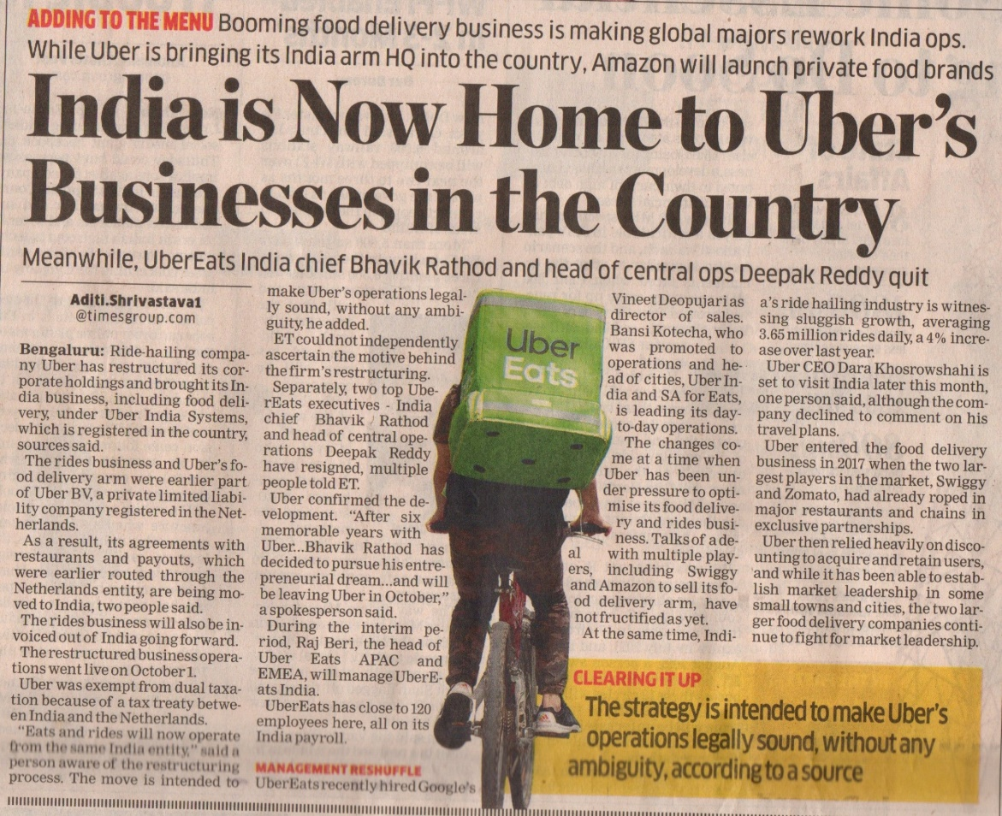
I.4.20
(i) Uber is moving its invoicing to India.
Accepting Indian taxation

Slide 82
My proposals - 17
There are two different ways of attributing profits. First:
I.4
Entirely dependent upon seller. Functions –
Purchase, Production.
Asset - Tangible & Intangibles Risks.
Marketing & Sales.
If the seller has none of these in COM, then it
has no taxable profit in COS.
Supply side.
Digital Taxation Rashmin Sanghvi

Slide 83
My proposals - 18
There are two different ways of attributing profits. Second:
I.4
Profits are contributed by both – Supply side &
Demand side, Seller & Buyer, COR & COM.
Hence COR & COM – both should have right
to tax a portion of the cross – border income.
Centre Supply Side & Demand Side.
Digital Taxation Rashmin Sanghvi

Slide 84
Global Trends –
Business Developments
II.5.(i).1
Year of Inception | Name of Company | Remarks
1996 | Apple | E Commerce sale started much later. All products sold for a price.
1997 | Netflix | Online streaming – web series, films etc. Expanded internationally in 2010. Subscription for a price.

Slide 85
Global Trends Business Developments
II.5.(i).2
Year of Inception | Name of Company | Remarks
1998 | Google | Most Services Free of charge. Dependent on Advertisement.
2004 | Facebook | Dependent on Advertisement.

Slide 86
Global Trends –
Business Developments
II.5.(i).3
Digital Taxation Rashmin Sanghvi
Amazon, Apple, Google & Facebook are considered Big 4 US Technology Companies.
Alibaba & Baidu are Big 2 Chinese Technology Companies.

Slide 87
Global Trends –
Business - USA
II.5.(i).4
Digital Taxation Rashmin Sanghvi
Between the years 1993 and 1997 several Digital Corporations were incorporated in USA. They flourished into global giants.
Amazon, Google, Apple, Uber, Microsoft & Netflix. Facebook came late in the year 2004.

Slide 88
Global Trends –
Business - China
II.5.(i).5
China prohibited entry of Google & Amazon. China developed its own Chinese companies –
Alibaba -Year 1999
Baidu - Year 2000
Swift action by China.
Inaction by India.
Digital Taxation Rashmin Sanghvi

Slide 89
Global Trends –
Business Developments
II.5.(i).6
Digital Taxation Rashmin Sanghvi
Today, globally there are two Digital giant countries: USA (epitome of capitalism) & China (epitome of communism).
Tatas, Birlas & many other industrial houses are large Indian groups. They were large houses before 1993. Europe to Australia had MNCs before 1993. Why only US & China developed Digital giants?

Slide 90
Global Trends –
Business Developments
II.5.(i).7
Digital Taxation Rashmin Sanghvi
Probably-
US & China have proved that –
Government & Business partnership encourages tremendous growth.
In India there is certainly no partnership between Government & Business.

Slide 91
Global Trends Technology
II.5 (ii) 8
Technology Telephone, TV, Computer, Robots, Internet, Satellites Mobile, Drones, Miniaturisation, all progressing.

Slide 92
Global Trends Technology
II.5 (ii) 9
Convergence of Unimagined new products.
Different technologies Artificial Intelligence.
Business Grabbing latest technologies for unimagined business models.

Slide 93
Global Trends OECD
II.5 (ii) 10
Law making Greed of nations, Conflicting
DTA Model vested interests do not allow reconciliation.

Slide 94
Year
1 India Recommended Consideration of 2000 new system for E-Commerce taxation.
High Powered committee Report
2 OECD Rejected 2005
II.6 (i) 1
Global Trends
Chronology

Slide 95
Global Trends
Chronology
II.6 (i) 2
  3 Britain Realised tax avoidance 2010
& Europe by digital MNCs is harming
their economics
4 OECD Started BEPS Action 1 to 15 2013
Gave final reports 2to 14 2015
Not yet finalized Action 1 Oct - 2019
5 India Imposed Equalisation 2016 Levy @ 6%
Year

Slide 96
Global trends
Chronology
II.6 (i) 3
Year
6 EU Published report on SEP 2017
Britain Proposed 2% tax on gross 2019
France Legislated 3% tax on gross 2019
USA Trump threatened Economic 2019
war against France

Slide 97
Global Trends
Chronology
II.6 (i) 4
10 USA: What is the significance of Digital tax that even US President has to threaten action ? What is the difference between Action by current U.S. President & earlier President? No difference. Only style has changed.

Slide 98
Global Trends
Chronology
II.6 (i) 5
Year
11 India amended s.9 of ITA &
Provided for SEP. Finance Act 2018 2019 For Attribution of profits
published rules 2019

Slide 99
Global Trends
Chronology
II.6 (i) 6
12 Who Rules OECD ?
13 Is OECD a global leader in taxation; or merely a lobby institution?

Slide 100
Issues
1 It is now admitted that –The existing System of- Sharing of Taxing Right is Defective. It needs to be improved.
2 Concept of PE is outdated – for Digital Economy. SEP may be considered.
3 Attribution of profits by FAR analysis is inadequate. FARM may be better.
II.6 (ii) 7
Global Trends

Slide 101
Global Trends
II.6 (ii) 8
  Issues
Rashmin: Equal distribution between COR & COM.
OECD proposal in 2nd interim report on BEPS Action One - So complicated that-
Most countries won’t understand.
Most countries won’t be able to implement. MNCs can get away with huge tax avoidance.

Slide 102
International Tax Exploitation
& Tax War
II.6 (iii) 1
When a powerful person exploits a weak Person; and the weak person does not protest– there is “equilibrium”.
There is peace.
When the exploited start protesting or fighting, there is war.
Results of war can be unpredictable.
Digital Taxation Rashmin Sanghvi

Slide 103
II.6 (iii) 2
Illustrations of Exploitation
(i) Women’s Right/Liberation
(ii) “Upper” caste Vs. “Lower” caste.
(iii) Developed Countries Vs. Under Developed Countries.
Digital Taxation Rashmin Sanghvi

Slide 104
Economic Wars
II.6 (iii) 3
Currency War | Dollarisation of Global Trade.
Trade War | Customs Duties Import Licensing Entry Barriers.
Tax War | Exploitation continued for several decades. Now is a hesitant war.
Economic War | U.S.S.R. Collapse – 1992. South East Asian Crisis – 1997
Digital Taxation Rashmin Sanghvi

Slide 105
Principles Vs. Reality
II.6 (iii) 4
Digital Taxation Rashmin Sanghvi
Under Hindu religion fundamental concept is “Advait”. “We are all one”. There is nothing upper & nothing lower. This caste system is pollution/ perversion of pure religion.
And yet, exploitation continues.
Wars also continue.
Notes:
2
n

Slide 106
Illustration of Exploitation
II.6 (iii) 5
Digital Taxation Rashmin Sanghvi
Study the principles.(निश्चय नय)
Be practical in life. (व्यवहार नय) We play ethically & fairly.
And yet be prepared & alert for others’ unethical behavior.

Slide 107
Global Trends US - Unilateralism
II.6.(iv).1
Copyrights
Google & You Tube Violate the Copyrights of the world. When world wanted them to honour Copyrights, they resisted. But when China violates US Copyrights, US Govt. is angry.
Digital Taxation Rashmin Sanghvi

Slide 108
US Unilateralism
II.6.(iv).2
USA initiated several global movements:
Environment protection, Nuclear Non-proliferation & several Global Agreements –
Yet, USA is not bound by any such agreements.
Rest of the world has to follow restrictions.
Obama executed agreement with Iran. Trump has broken the agreement.
Why this unilateralism is accepted by the world?
Digital Taxation Rashmin Sanghvi

Slide 109
US Unilateralism
II.6.(iv).3
Digital Taxation Rashmin Sanghvi
When OECD started BEPS programme in the year 2013-
USA made it clear that it will not sign MLI. Rest of the world may follow BEPS programmes. And yet, US representatives participated in all 15 BEPS programmes & dominated the discussions.
In 2019, USA has not signed MLI.

Slide 110
U.S. Unilateralism
II.6.(iv).4
Indirect tax
PE | requires fixed place of business in COS. In absence of a fixed place of business in COS, that Govt. cannot tax a NR’s business income.
SEP | does away with the need for fixed place of business. Now you have a way to tax the NR Digital giants.

Slide 111
U.S. Unilateralism
II.6.(iv).4
Indirect tax
PE | requires fixed place of business in COS. In absence of a fixed place of business in COS, that Govt. cannot tax a NR’s business income.
SEP | does away with the need for fixed place of business. Now you have a way to tax the NR Digital giants.

Slide 112
U.S. Unilateralism
Indirect Tax
II.6.(iv).5
In USA, every state government levies sales tax. Earlier, a corporation from one US state - selling goods & services in other states – without having any shop or warehouse in that state avoided sales tax in the State of Market.
U.S. Supreme Court decided in South Dakota case in June 2018 that “sales” is adequate nexus to make a company liable to sales tax. No need for fixed place of business.
Concept of Sales being SEP has been accepted by US SC & by US Central & State Governments.
Digital Taxation Rashmin Sanghvi

Slide 113
US Unilateralism
II.6.(iv).6
Digital Taxation Rashmin Sanghvi
Indirect tax
Now internally, US Govt. accepts that SEP is adequate nexus to tax Non-Residents.
However, till the year 2019; US opposed SEP as a nexus for Digital tax.
In the year 2019 interim reports have been published with SEP as one option.
It completely dilutes the real concept of SEP.

Slide 114
US Unilateralism
II.6 (iv) 7
Digital Taxation Rashmin Sanghvi
On E-Commerce, US tax authorities had decided during President Obama’s regime that:
We will not allow BEPS Action One programme to conclude before the year 2020.

Slide 115
US Unilateralism
II.6 (iv) 8
Digital Taxation Rashmin Sanghvi
During president Trump’s regime, USA has passed GILTI & BEATS. Reduced corporate tax to 21%
Given incentive to US MNCs to bring back all profits retained abroad @ 10% tax- within a few years.
Those who do not bring in the funds will face action.

Slide 116
US Unilateralism
II.6.(iv).9
Digital Taxation Rashmin Sanghvi
Now US will not be affected by global law on Digital Economy. Now OECD – G20 can finalise Digital Taxation rules under BEPS Action One.

Slide 117
U.S. Unilateralism
Lone fighter
II.6.(iv).10
Digital Taxation Rashmin Sanghvi
From the year 1999 to 2019,
I am probably one of the few persons raising my voice for a FAIR global E- Commerce taxation system. Many tax commissioners have fought. But on being transferred from the relevant department, they have left the issue.
In OECD – Senior executives and, US IRS officers have rejected my proposals.

Slide 118
U.S. Unilateralism
Lone fighter
II.6.(iv).11
Digital Taxation Rashmin Sanghvi
I understand that – they are all loyal to USA- irrespective of their citizenship.
But even Indian citizen stalwarts in international taxation rejected proposal for a fair System.
Why ?
(Jacques Sasseville is a Canadian Citizen.
Pascal Saint Ammans is a French Citizen.)

Slide 119
US Unilateralism
US – Tax Haven?
II.6.(iv).12
Rest of the world is bound by FATCA & information exchange agreements - under – DTA, PMLA, BEPS etc. U.S. is not bound by BEPS programme.
Under FATCA India has got some nominal rights to get information. Rest of the world has to report information on US tax payers. But US does not have to report on other Countries’ tax payers.
Digital Taxation Rashmin Sanghvi

Slide 120
US Unilateralism
US – Tax Haven?
II.6.(iv).13
Digital Taxation Rashmin Sanghvi
Why is it that after BEPS Programme – Black Money hoarders who ran away from Switzerland, Singapore, etc.- have gone to USA?
U.S. has developed an entire economic & legal system where funds from rest of the world flow into USA. Black or White.
U.S. is world’s largest debtor country. It continues to increase its debt by $ 700 billion every year.

Slide 121
US unilateralism
II.6.(iv).14
OECD takes more than 20 years to come out with a good draft of Digital Tax System.
USA disregards MLI and commands others- not to have Unilateral law.
Disobeying the commands can invite Economic War.
Digital Taxation Rashmin Sanghvi

Slide 122
Impractical Theories
II.6 (v) 1
OECD is reduced to pure Theoretician body . It produces massive reports which can not be practiced.
Most MNCs who have PEs in India, have no clear, practical, objective way of determining Attribution of profits.
There are transfer pricing formulas. All are theoretical & highly subjective. There are ad hoc solutions.
Digital Taxation Rashmin Sanghvi

Slide 123
Global Trends OECD
II.6 (v) 2
1997
Oct. 2019
OECD first published OTTAWA Report on E – Commerce.
Started work on it.
Has still not been able to come out with good provision for Digital tax
22 years for one provision. Reflects conflicting vested interests.

Slide 124
Global Trends OECD
II.6 (v) 3
USA Vs. Rest of the world.
China
Is OECD working as a U.S. Institution?

Slide 125
Global Trends
India’s Concern
II.6 (v) 4
If we insist on a Digital Tax,
US, Japan etc.
Can tax our software exports.
India can be a loser.
Possibly.
Issue here is of having a Just & fair system of taxation.
Situations can keep changing.

Slide 126
International Tax War Future
II.7.1
What are we witnessing ?
This is an International Tax War. One strong nation harasses rest of the world. Other nations are scared.
What they need to fight back is- “Their own fear”. Tell the truth Bluntly.
Truth Liberates. Truth is simple.

Slide 127
International Tax War Future
II.7.2
But to tell the Truth, one has to know and understand the Truth.
Global system has hidden the Truth behind avoidable complex & complicated theories.
I am trying to present the Truth or I see it and discard avoidable complexities & complications.

Slide 128
International Tax War Future
II.7.3
Why are India & world facing Recession?
Economic War.
Trade War.
Tax War.
All these Wars are an UGLY DANCE of GREED.
And greed Causes Fear. Fear Paralyses.
Recession is a natural consequence.

Slide 129
International Tax War Future
II.7.4
What is the solution?
Majority of governments stop being Greedy.
Play a just & fair role – in a Win-Win manner;
in Good faith.
Fair & Equitable Growth is guaranteed.
Is it pure Idealism to expect Governments to stop being greedy?
For a spiritual person all these characteristics are natural.

Slide 130
International Tax War Future
II.7.5
When can we expect Governments to act fairly?
After all tax consultants & tax payers start practising & paying taxes fairly.
Digital Taxation Rashmin Sanghvi

Slide 131
And Finally
Apologies - My presentations are generally very long. Because every year I have something more to say. This world creates unnecessary complications. To break down the complications needs time.
May God Bless this world with a simple, fair & efficient system of international taxation.
Pranam
Rashmin Sanghvi

